Slide 1
Software Testing
Testing is the process of exercising a
program with the specific intent of finding
errors prior to delivery to the end user.
Testing is the one step in the software
process that could be viewed
psychologically as destructive rather than
constructive

Slide 2
Testing Objectives
Testing is a process of executing a program with the intent of finding an error
A good test case is one that has a high probability of finding an as- yet – undiscovered error
A successful test is one that uncovers an as – yet – undiscovered error

Slide 3
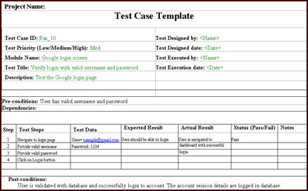

Slide 4
Testing Principles
All tests should be traceable to customer requirements
Tests should be planned long before testing begins
Testing should begin “in the small” and progress toward testing “in the large”
Exhaustive testing is not possible
To be most effective, testing should be conducted by an independent third party

Slide 5
Who Tests the Software?
developer
independent tester
Understands the system
Must learn about the system,
but, will test "gently"
but, will attempt to break it
and, is driven by "delivery"
and, is driven by quality

Slide 6
Exhaustive Testing
loop < 20
14
There are 10 possible paths! If we execute one
test per millisecond, it would take 3,170 years to
test this program!!

Slide 7
Selective Testing
Selected path
loop < 20

Slide 8
Types ofTesting
Black box testing
White box testing

Slide 9
Black Box Testing
Knowing specified function that a product has been designed to perform, tests can be conducted that demonstrate each function is fully operational while at the same time searching for errors in each function

Slide 10
Black Box Testing
Focus on interfaces
Inputs and outputs
Integrity of external information e.g., a database

Slide 11
Black-Box Testing
requirements
output
input
events

Slide 12
Black-Box Testing
Also called Behavioral Testing or Functional Testing
Focus on:
Functional Requirements of the software
I.e. Inputs, Outputs
Structure of program is not considered
Black box testing is not an alternative of white box testing
Different kind of errors are uncovered in each technique

Slide 13
White-Box Testing
... our goal is to ensure that all
statements and conditions have
been executed at least once ...

Slide 14
Why Cover?
White-Box Testing
logic errors and incorrect assumptions
are inversely proportional to a path's
execution probability
we often
believe
that a path is not
likely to be executed; in fact, reality is
often counter intuitive
typographical errors are random; it's
likely that untested paths will contain
some

